Slide 1
Islamic & Modern Western Economic Systems: An In-Depth Analysis & Comparison
Presented by:
Danial Ahmad (331388)
Muhammad Ahmed Mohsin (333060)
Muhammad Umer (345834)
Imran Haider (332569)
Tariq Umar (334943)
Saad Bakhtiar (341150)

Slide 2
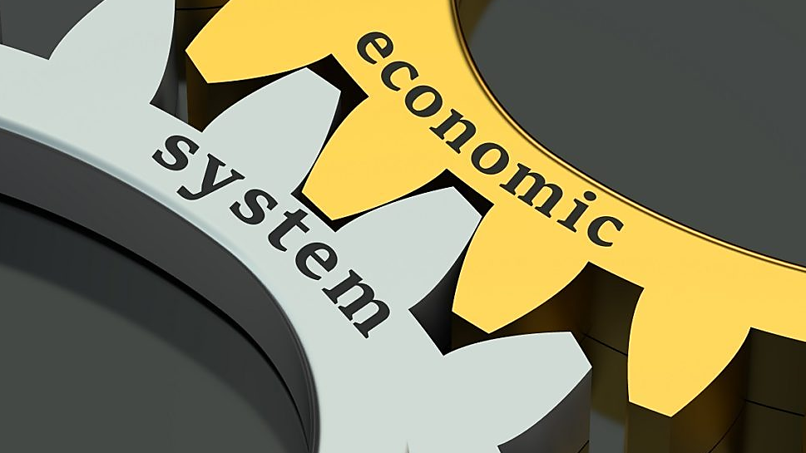

Slide 3
Introduction
Definition
An economic system is a mechanism which deals with the production, distribution & consumption of goods & services in a particular society and comprises of people, institutions and their relationships
It addresses problems like allocation or scarcity of resources.
What really is an economic system?

Slide 4


Slide 5
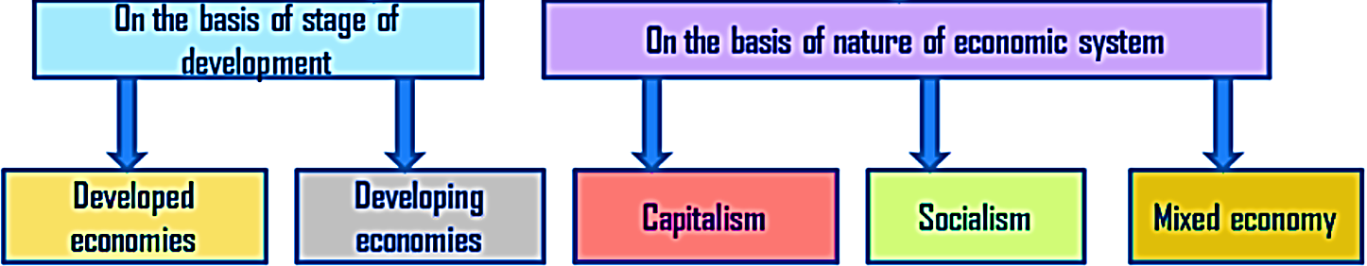
Type of Western Economies
Our focus is on analyzing the different natures of western economies & contrast them with the basis of an Islamic one

Slide 6
Capitalism
Principles of Capitalism
Private Ownerships
Free Markets
Profit Driven
Profits & Losses
Profits are closely associated with the concept of private property
Voluntary Trade
Voluntary trade is the mechanism that drives activity in a capitalist system
An economic system in which the means of production (capital) are privately owned, and goods and services are produced for profit in a free market.

Slide 7
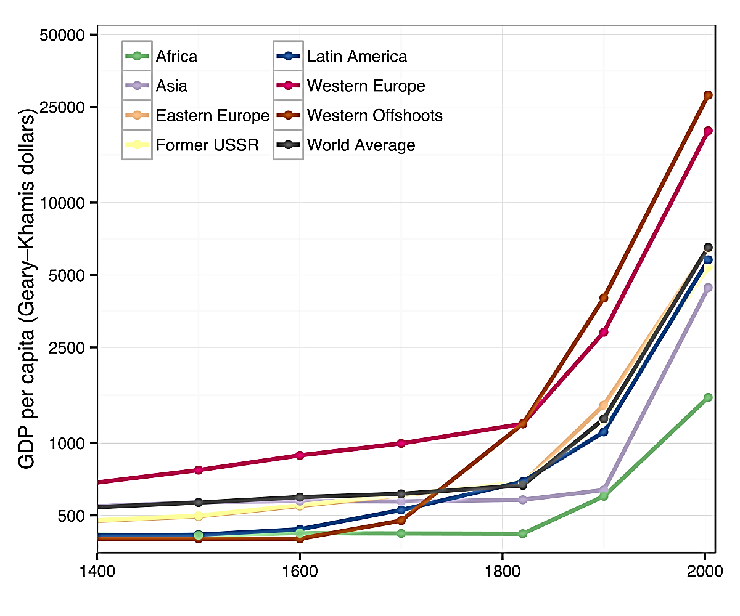
Capitalism & Economic Growth
Capitalism has shown to be a highly successful vehicle for economic progress
Prior to the 18th and 19th centuries, rapid economic growth was mostly achieved by conquest
Average global per-capita income remained unchanged until the first Industrial Revolution began

Slide 8
Communism
The Communist Manifesto was written by Karl Marx and Friedrich Engels in 1848
This view of economy puts socialism in opposition to capitalism
A common disagreement amongst socialists
The centralists who want a central group or party to have public control
The decentralists who want the local people who are directly affected by it
A theory or system of social organization in which all property is owned by the community and each person contributes and receives according to their ability and needs

Slide 9
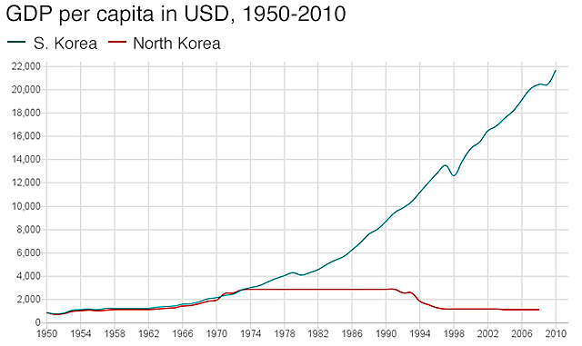
Communism: Pros and Cons
Pros
Everyone gets goods according to their needs
No concentration of wealth amongst a few
Assurance of supply with medical equipment
Lower unemployment rates
Cons
Difficult to accumulate wealth
No economic freedom
Lack of motivation in citizens
History shows its bad for economy

Slide 10
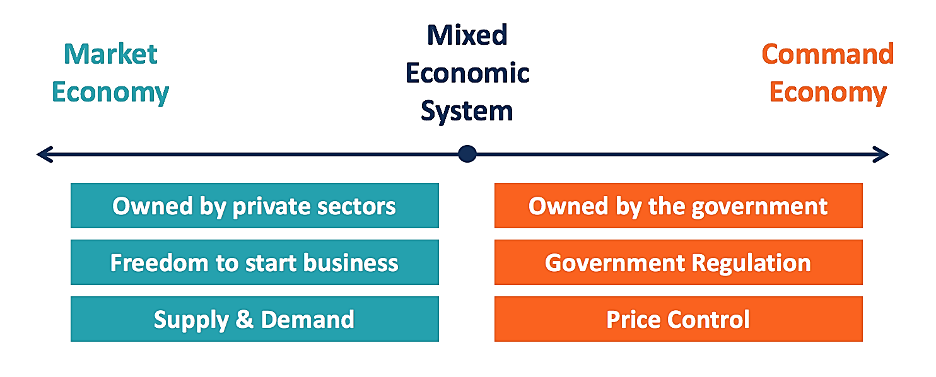
Mixed Economy
Mixed economy combines various aspects of market and command economies
Most of the countries around the globe utilize mixed economic policies to varying extents
For example, in a mixed economy, post offices and other government buildings are controlled by the government while still allowing for private ownership in other industries such as restaurants, etc.

Slide 11
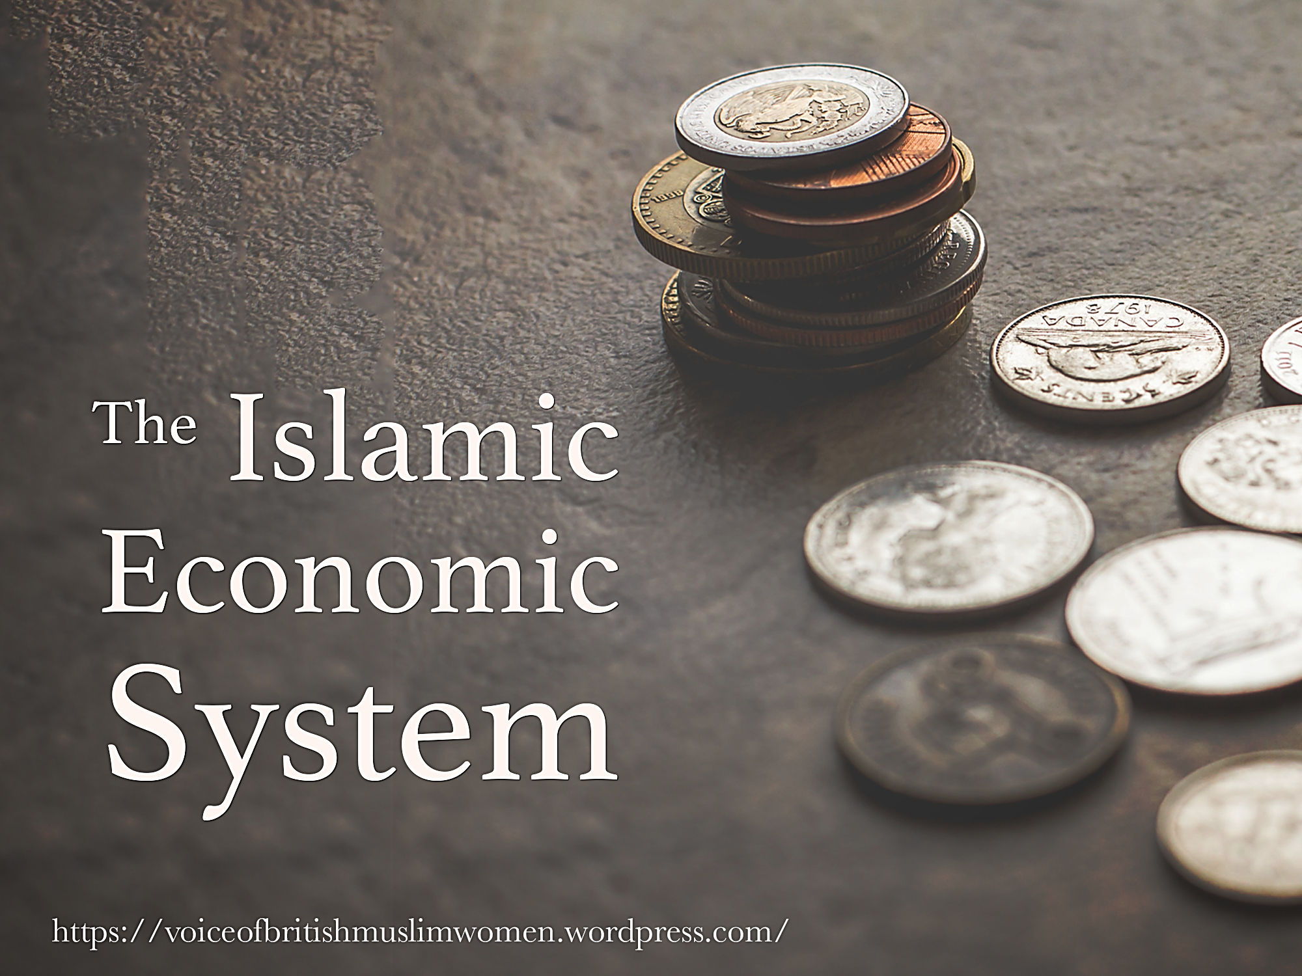

Slide 12
Islam’s Perception of Money
Perception
Money is used as a unit of account in Islam to determine the relative value of products and services.
Only when it is exchanged for a real asset or used to purchase services does it become valuable.
Value
It is a means of exchange rather than a source of value.
All money units of the same denomination are identical.
Money cannot be sold or purchased on a credit basis.
The Divisive Line between Western and Islamic Economic Policies

Slide 13
Islamic Viewpoint: Money & Commodity
Money
Money has no intrinsic utility whereas a commodity has an intrinsic utility and can be utilized directly.
Commodity
Commodities can have a variety of qualities, whereas money's only quality is that it is a measure of value or a medium of exchange. Money's solitary quality is that it is a measure of value or a medium of exchange.
Shariah treats money differently from commodities for the following reasons:
Money is not permitted to be traded in the same way that other commodities are.
If money has to be traded for money or borrowed for a special reason, both parties must pay the same amount so that it isn't utilized for something it wasn't intended for.

Slide 14
Era of Hazrat Umer R.A
Economic Policies
Foreign exchange
Zakat
Laid the foundation for charity and philanthropy
Centralized the collection of zakat especially outside the Arab mainland
Once Mahatma Gandhi mentioned “Abu Bucker (RA) & Umar Ibn Khattab (RA)”
They were leaders of vast empire, yet they lived a life of austerity.

Slide 15
Era of Hazrat Umer R.A
Ghanimah (Spoils of War)
Booty is the property confiscated from the Muslims of the army of infidels with the war path. The fundamental problem on the distribution of booty was taken by Hazrat Umer and is given as:
Shafi
One fifth in the name of Allah to Prophets relatives, orphans, needy, etc.
One fifth was distributed among soldiers
Kharaj
Kharaj system is a system where the tax was imposed on the rulers in the newly conquered territories which generated a lot of revenue for the state
Al-Fai
Fai is the booty left by the enemy. It is the property that is taken from the pagans and is not captured because of war.
This Fai is divided into five sections and those sections areas:
To Allah and His Messenger
The Prophet’s Kin (Banu Hashim and Muttalib)
Orphans
The Poor Ibnu Sabil
Four-fifths of the booty was distributed to those who join the battle

Slide 16
Era of Hazrat Umer R.A
Usyur
It is the money taken by the country from the merchants that pass through the country. standardization of customs imposed on merchants and their merchandise for passing through international boundaries within the caliphate.
Bait-ul-Maal
Although Bait-up-Mal was a system existing before Hazrat Umar R.A reign, it was he who centralized it into a proper financial institution whose job was to manage the states collected finances and distribute wealth among the needy to reduce poverty and create a proper welfare state.
Infrastructure Projects & Free Trade
New roads
Canal system
Increased agriculture growth
Food storage and disaster management
The Caliph’s Personnel Sympathy
Caliph Umar RA's sense of justice does not seem to have been merely theoretical. Indeed, there are many accounts of his being a true man of the people, patrolling the streets in person to see the state of the population under his responsibility

Slide 17


Slide 18
Fundamental Differences in Perspective
Conventional Systems
Money, in addition to being a medium of trade and a store of value, is a commodity.
The rationale for charging interest on capital is time value.
Even if the organization loses money by using the bank's finances, interest is charged. Therefore, it lacks the element of being a profit-and-loss-sharing system.
There is no agreement for the exchange of goods and services while disbursing cash financing, running finance, or working capital finance.
Islamic System
Money is a medium of exchange and a store of value, but it is not a commodity.
Profit is earned through the sale of commodities or the charging of fees for providing services.
Profit and loss sharing is the basis of Islamic banking. Upon incurring losses, the bank will split those losses with the businessperson based on the manner of financing used.
While disbursing payments, it is required to execute agreements for the exchange of products and services.

Slide 19
Fundamental Differences in Perspective
Communist Systems
Defined from the philosophy of mind and the experience gained from the failure of capitalistic system.
Limited rather abolished Individual ownership of money/capital.
No competition between business, as price is controlled by price adjustment mechanism which somewhat favors the people.
Government or state acts as the owner or ruler of the economy and controls all economic activities.
Human apathy is the main source.
Islamic System
Conveyed through Quran, As-Sunnah and later explained by Islamic scholars.
Individual ownership of money/capital is permitted.
There is competition between business that is controlled by sharia laws.
Governments act as supervisors to control and referee economic activities in the country.
Islamic laws and fear of judgement day acts as a motivating force.

Slide 20
Fundamental Differences in Perspective
Capitalist System
The oldest form of economic system, defined through one’s sense of complete ownership.
Absolute Individual ownership of money/capital, and market mechanism allows to work alone.
There is a good competition between business, or sometimes complete monopoly but there are means to regulate the prices.
Individuals or firms acts as the owner or ruler of the economy and controls all economic activities.
Earning profit is the only motivating force.
Islamic System
Conveyed through Quran, As-Sunnah and later explained by Islamic scholars.
Individual ownership of money/capital is permitted but market mechanism works on Masalhat.
There is competition between business that is controlled by sharia laws.
Governments act as supervisors to control and referee economic activities in the country.
Islamic laws and fear of judgement day acts as a motivating force.

Slide 21
Conclusion
Western Economic Systems
Capitalism
Communism
Islamic Economic System
Money is more of a medium of exchange than a source of value
Fundamentally, an Islamic economic system does not differ much from mixed-economy
Remarks
All economic systems have their own advantages and disadvantages
Proper implementation of any one of these economic systems can eliminate many of the difficulties that the economy faces today

Slide 22
Thank You
Any Questions?

